Slide 2







Q1. A transistor has β = 150. Find the collector and base currents, if I_{E} = 10 mA.
$$β=150 I_{E}=10mA$$
$$α=\frac{β}{1+β}$$
$$=\frac{150}{151}=0.993$$
$$I_{c}=αI_{e}$$
$$=0.993(10mA)=9.93mA$$
$$I_{e}=I_{b}+I_{c}$$
$$I_{b}=0.07mA$$

Slide 3
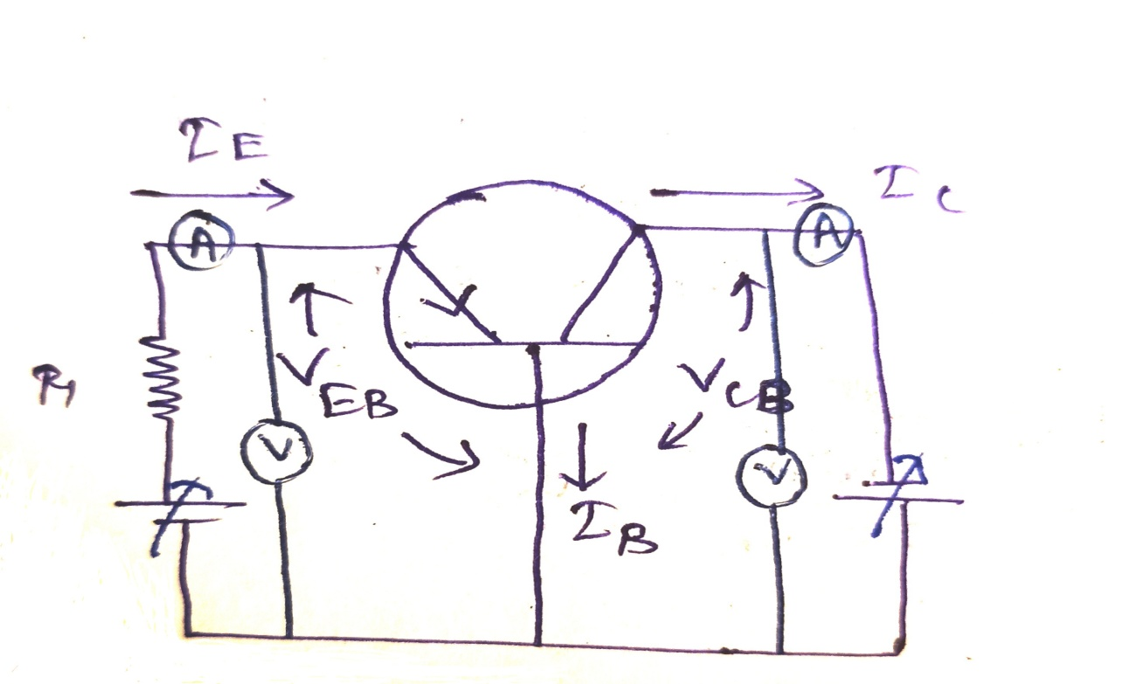
CB Conf.
The plot between i/p current (I_{E}) and i/p voltage (V_{EB}) for different o/p voltage (V_{CB}) is caled i/p char. of CB configuration.
As i/p side emitter base junction is forward biased like PN junction,the char. look like diode charecteristics i.e for constant V_{CB} when V_{EB} increases,I_{B} also increases exponentially.
When V_{CB} increases,depletion layer of CB junction increase which will decrease the effective base width and the process is called as base width modulation/Early effect.
Due to decrease in effective base width for increase in V_{CB,}I_{B} decreases which is shown in Figure.

Slide 4
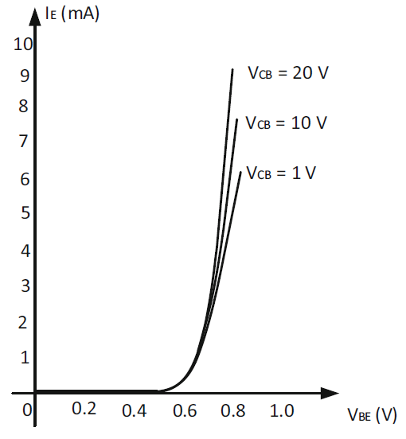
Input Characteristic
To determine the input characteristics, the collector-base voltage VCB is kept constant at a particular voltage and VEB is increased to some voltage and the corresponding emitter current is measured. This experiment is repeated for different value of V_{CB}
From this curve it is observed that:
The input characteristic behave like a forward characteristic of a PN junction diode
The emitter current increases with increases in V_{CB} voltage
Reason:
By increasing the V_{CB}, the base width become further decreases.
The decrease in the effective base width by increasing the reverse bias voltage of B-C junction is called as “Early Effect” or “Base width modulation”
Thus, the base current is less. As a result emitter current increases.

Slide 5
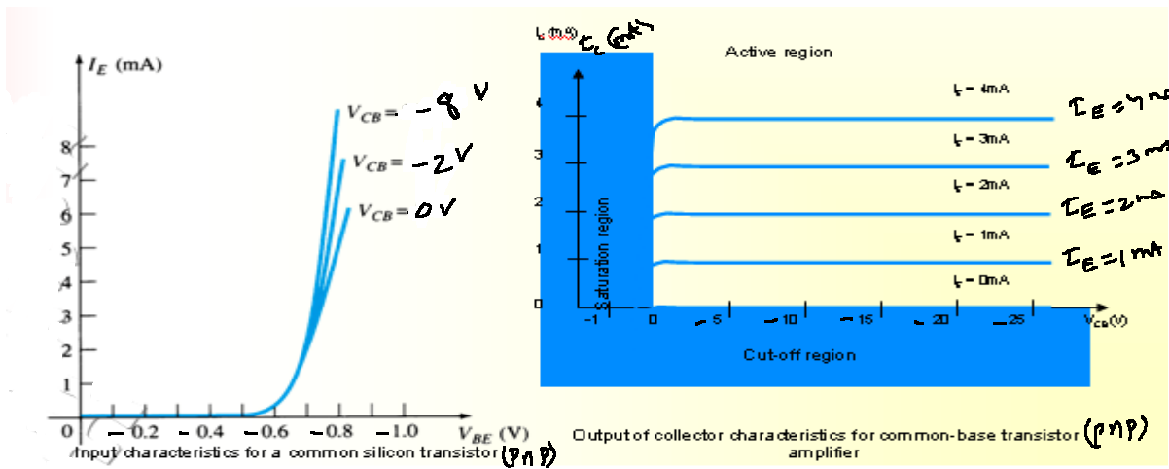
CB i/p & o/p Char.
The plot between o/p current (I_{C}) and o/p voltage (V_{CB}) for different i/p current (I_{E}) is called o/p charecteristics.
The o/p char. is divided into three regions.
Active Region
Saturation Region
Cutoff Region

Slide 6
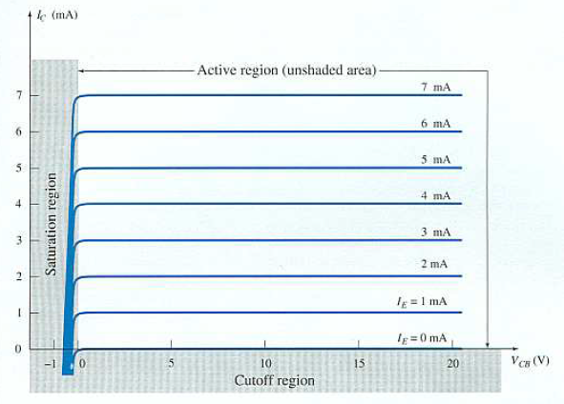

Output Characteristic
To determine the output characteristics, the emitter current I_{E} is kept constant at a suitable value by adjusting the emitter-base voltage V_{EB}. Then V_{CB} is increased in suitable equal steps and the collector current I_{C} is noted for each value of I_{E}.
It is repeated for different value of I_{E}
$$I_{c}≈I_{e}$$
So, Collector current is independent of V_{CB} voltage.
The output characteristic behave like a reverse characteristic of a PN junction diode
In the active region, both B-E and B-C junction are forward and reverse biased, respectively.
In the cut-off region, both B-E and B-C junction are reverse biased
In the saturation region, both B-E and B-C junctions are forward biased

Slide 7
Active Region: The transistor used as an amplifier should operate in active region.In this region EB junction forward biased and CB junction reverse biased.
If emitter current (I_{E}=0) then I_{C}=I_{CO}(reverse saturation current).
As EB junction is forward biased,I_{E} flows and I_{B} current is very less so almost all the currents reach to collector from emitter and I_{C} almost equal to I_{E}.
I_{C} is nearly constant and almost parallel to I_{E}.
Saturation Region: In this region both the junctions are forward biased.
Saturation region is located to left of the ordinate (V_{CB}=0) and above I_{E}=0.
As the CB junction is forward biased,holes will flow from collector to emitter so that we will get zero collector current when we increse V_{CB} in forward biased.
Cutoff Region:On this region,both the junction are reverse biased.
This region is located below I_{E}=0 i.e leakage current.
Breakdown Region:If VCB increase beyond limit then IE increase and goes to breakdown condition.This must be avoided.

Slide 8
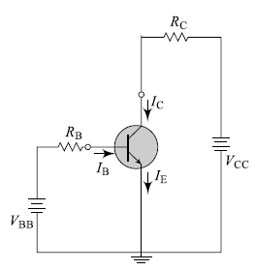
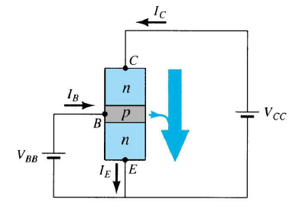
Common Emitter
In the common-emitter (CE) configuration, the emitter terminal is common to both the input and output ports.
V_{EC}-V_{EB}-V_{BC}=0
V_{BC}=V_{EC}-V_{EB}→V_{CB}=V_{CE}-V_{BE}
V_{CE}↑→V_{CB}↑

Slide 9
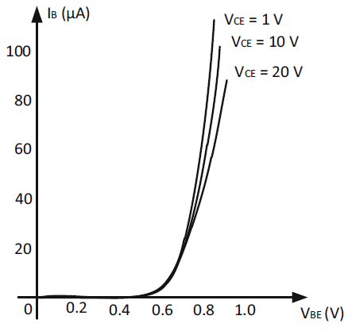
Input Characteristic
The common emitter input characteristic indicates the manner in which the base current I_{B} varies with changes in the base-emitter voltage V_{BE}, the collector-emitter voltage being held constant.
The curve has a shape similar to that of diode
The input current decreases with increase of output voltage

Slide 10
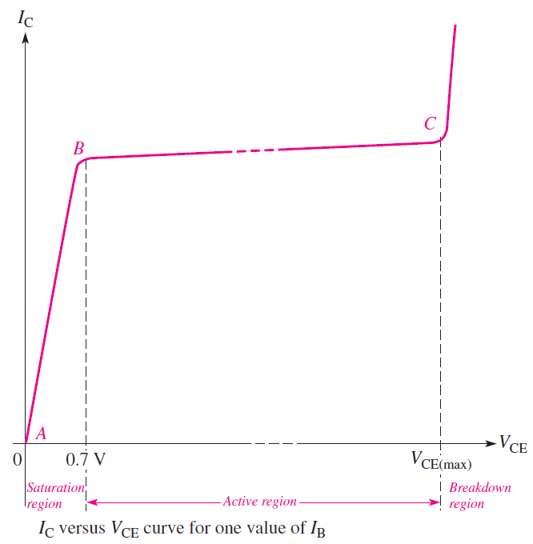
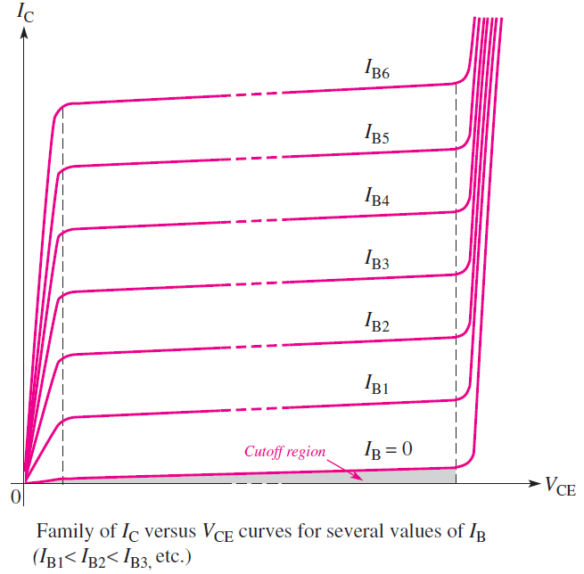
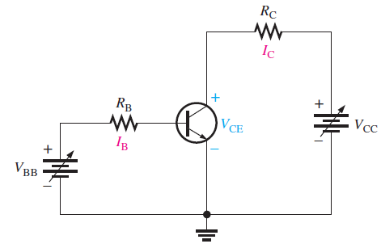


Output Characteristic
The output characteristic illustrates the manner in which collector current IC changes with collector emitter
voltage VCE for constant input parameters such as base current and base-emitter voltage
Initially, the V_{BB} is set to produce a specific value of I_{B} and V_{CC} is set as zero, then I_{C} = 0 and V_{CE} = 0.
The Vcc gradually increases from zero to a different voltage level
.
$$I_{C}<βI_{B}$$
In the cutoff region
$$I_{CEO}=\left(β+1\right)I_{CBO}$$

Slide 11
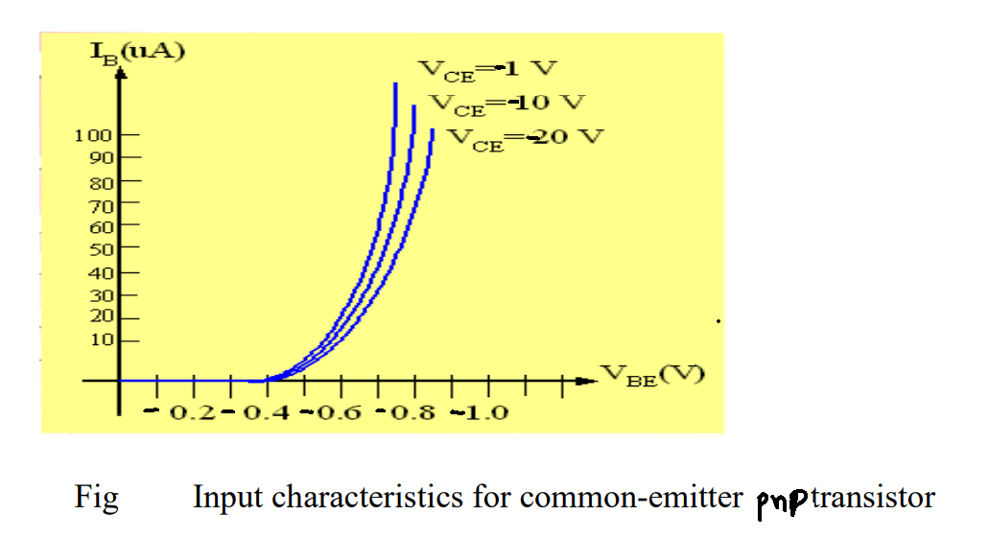
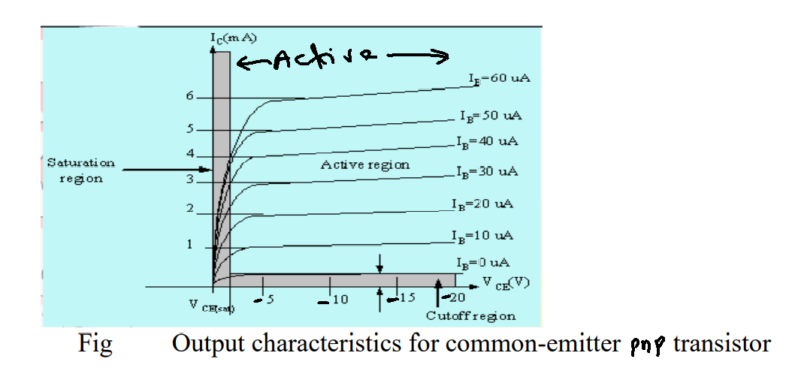
CE i/p & o/p Char.
The plot between V_{CE} and I_{C} for different value of I_{B} is called o/p char. of CE configuration.
The o/p char. is divided into three regions.
Active region:where EB junction is FB and CB junction is RB.
The curve in this region is not horizontal as in CB char. for fixed I_{B}. Here I_{C} increases with V_{CE} increase due to base width modulation.
Cutoff Region:In this region both junctions are reverse biased.
Saturation Region:In this region both the junctions are forward biased.

Slide 12
Saturation Region:
When V_{CE} voltage is zero and B-E junction is on forward bias, collector current is zero, all current flow through base emitter junction.
Further increase in V_{CE} , I_{C} will increases, it continues to increase till V_{CE} exceeds V_{BE}
At a particular level of V_{CE,} I_{C} will not change with increase in V_{CE.} Upto that region is called as saturated region
When a transistor is saturated, the collector current, I_{C} , is not controlled solely by the base current, I_{B} .

Slide 13


Active region:
The active region of a transistor is where the collector curves are nearly horizontal.
When a transistor operates in the active region, the collector current, I_{C} , is greater than the base current, I_{B} , by a factor of beta.
In the active region, the ccollector current slightly increases with increases of V_{CE.} It is due to early effect or base width modulation.
For a particular transistor Beta is considered as constant. Output current is function of input current. So the transistor is called a current controlled device
Cutoff region:
The cutoff region occurs when the E-B( i.e. input current I_{b}=0) and B-C junctions are in reverse bias.
In the cutoff region, only a small collector current, I_{C} , flows which is due to the leakage current in B-C junction.
$$I_{c}=βI_{b}$$
$$I_{CEO}=(1+β)I_{CBO}$$

Slide 14
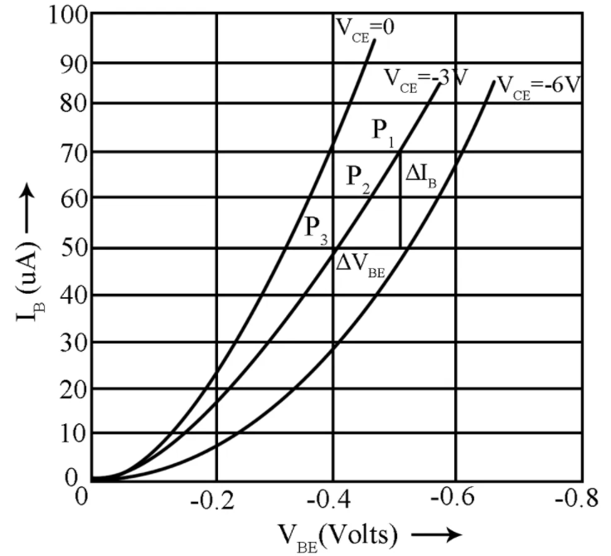
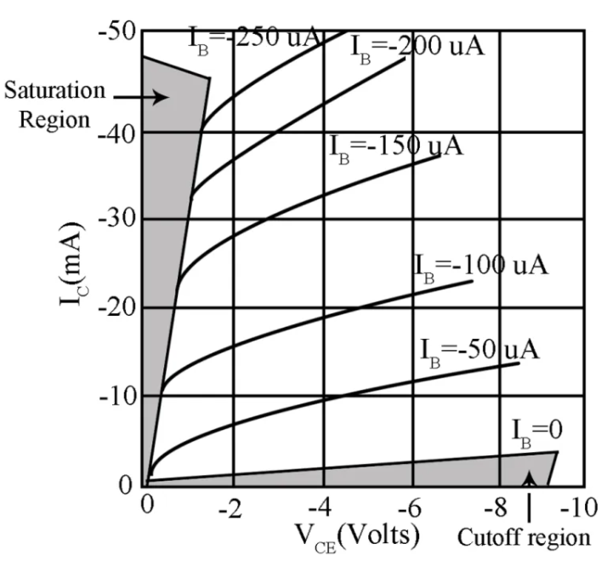
Characteristic of CE configuration PNP transistor
Output Characteristic
Input Characteristic

